Slide 1
CS 1: Welcome and Introduction
CS 163 and CS 164: Java Programming
Colorado State University
Computer Science Department
Slides Originally Created by Albert Lionelle (Albert.Lionelle@colostate.edu)

Slide 2
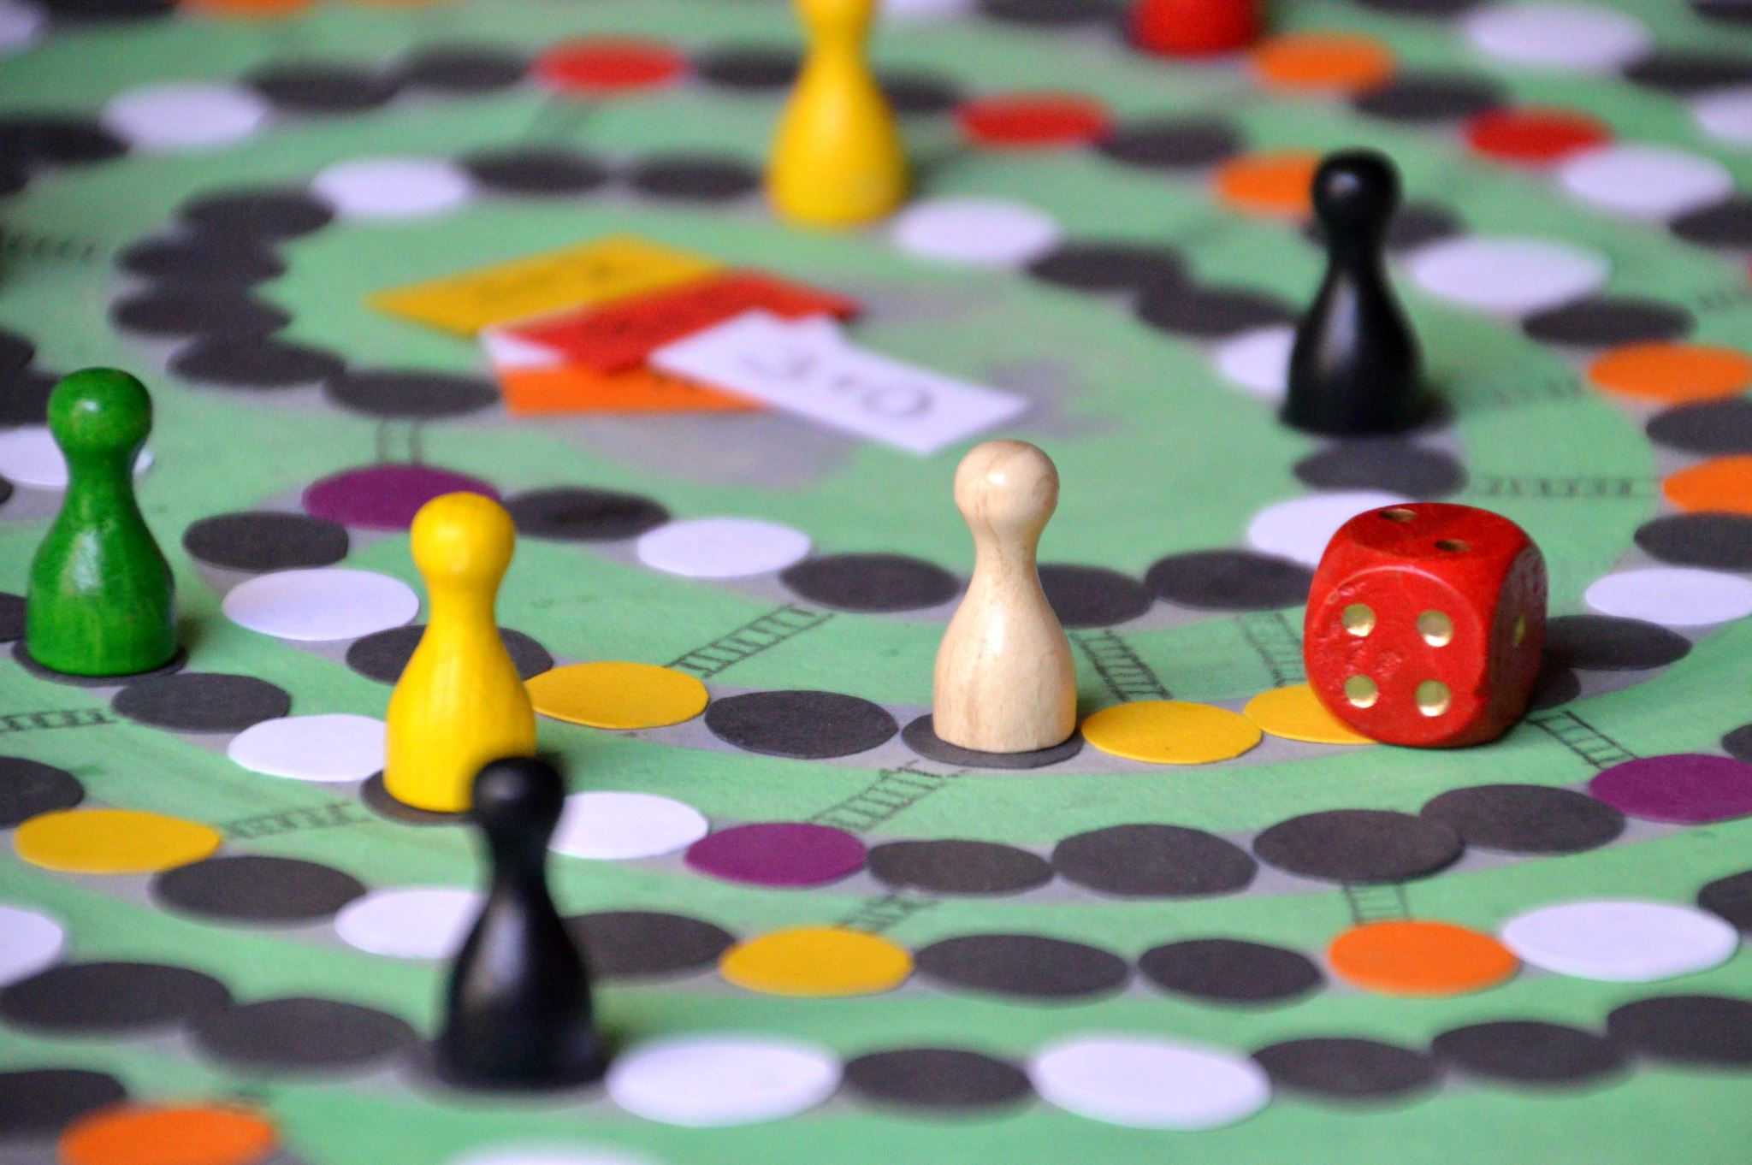
Weekly Announcements!
TODO Reminders:
Setup MS Teams
Reading 1 (Zybooks)
Syllabus Quiz
Knowledge Check
Will have these up every week!
Start of every class as you come to class.
ACM / ACM-W - Welcome Back Boardgames!
Pinon Hall 131 (the study area)
Thursday (26th) 6:00 PM
A super popular event, great way to meet others in the major, and have fun!

Slide 3
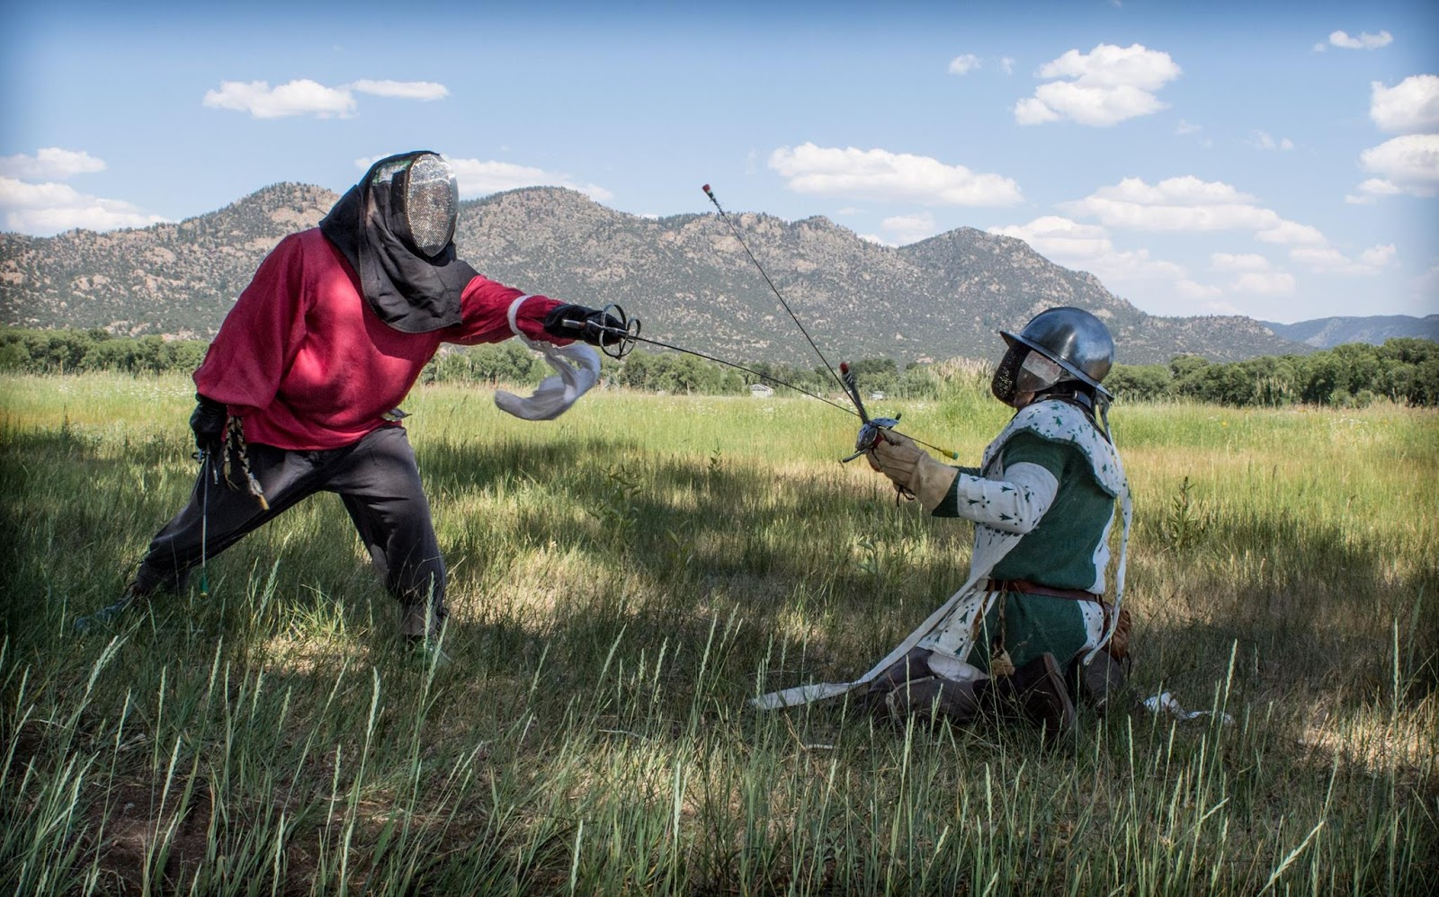
Instructor: Who Am I?
Masters of Science in Computer Science - From CSU!
Studied Computer Vision: Merging of Artificial Intelligence and Computer Graphics
PhD Candidate CSU
Worked in Industry for 10 years
Raytheon IIS
US Soil - co-owner
Real Food and Health Magazine - co-owner
Principal of an alternative high-school
Research Interests
Computer Science Education
Learning Analytics
Diversity in Computer Science
Outside Interests
Society of Creative Anachronism (Living History Recreators)
Rapier and Longsword - Historical Martial Arts (I learn and teach)
Dancing and Theater

Slide 4
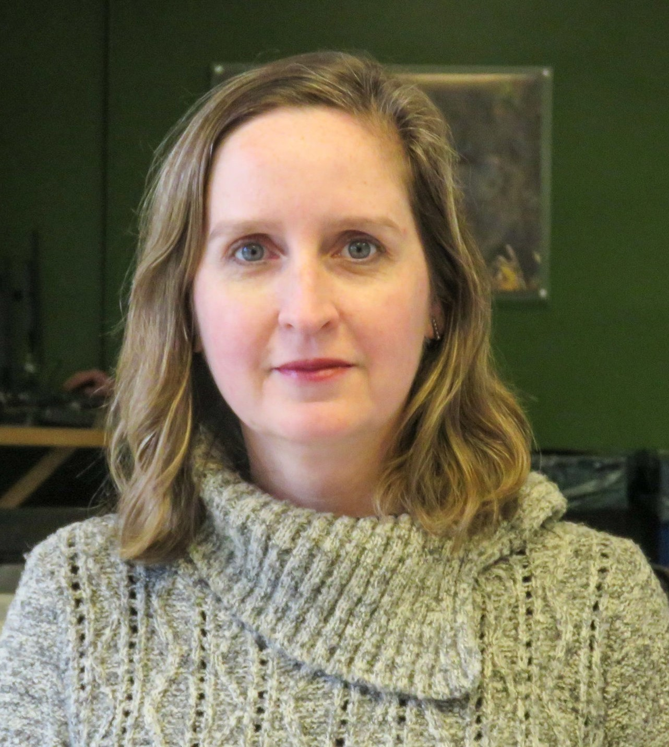
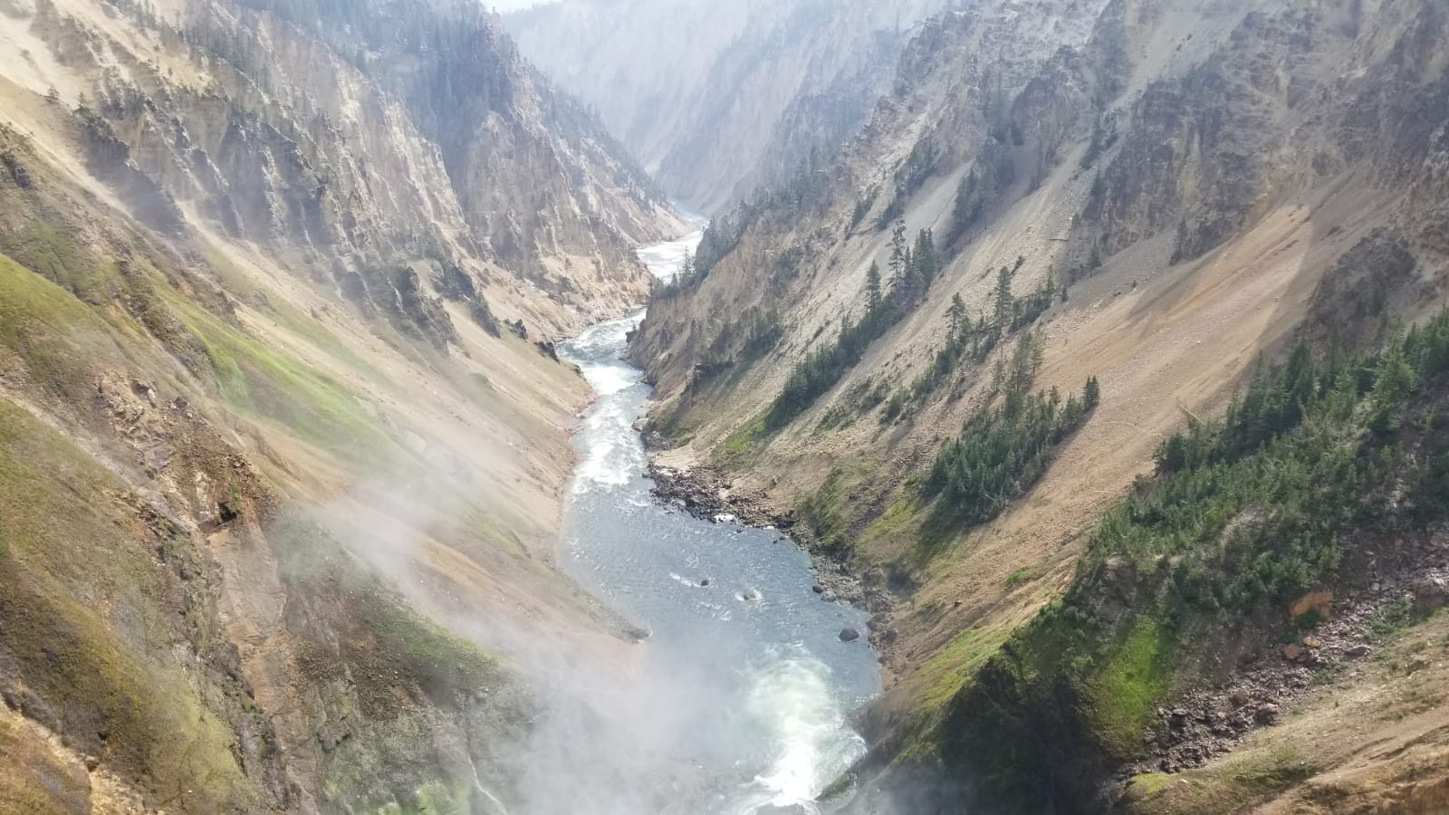
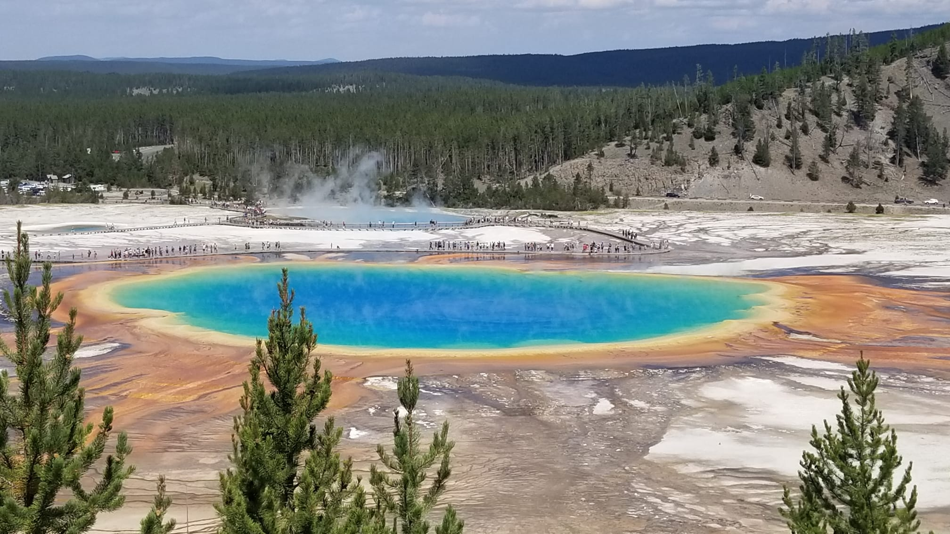
Who Am I?
PhD in Computer Science from Federal University of Rio Grande do Sul (UFRGS), Brazil
Artificial Intelligence applied to Education
PhD Student in Education Science working with Learning Analytics, School of Education, CSU
21 years of experience in Higher Education
16 years as Assistant Professor at the Computer Science Department, Pontifical Catholic University of Rio Grande do Sul (PUCRS), Brazil
5 years as a researcher at the Center for the Analytics of Learning and Teaching (C-ALT), CSU
Research Interests
Computer Science Education
Learning Analytics
Technology Enhanced Teaching and Learning
Outside Interests
Reading
Traveling with my family
Riding my bicycle

Slide 5
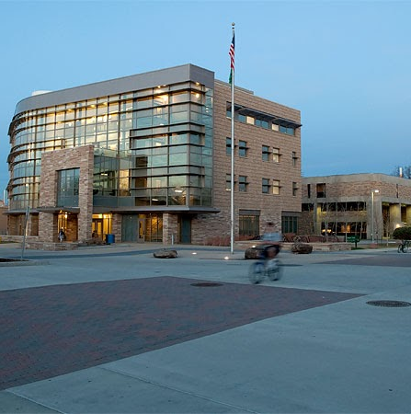
Instructor: How to Contact Me?
MS Teams Private Message
*BEST WAY*
email (poor), canvas (very bad!!)
General questions
Post in the general channel!
Let’s other see the answer
Check the Syllabus for Office Hours!
Mixed MS Teams and Office
stop by either but may need to wait.

Slide 6
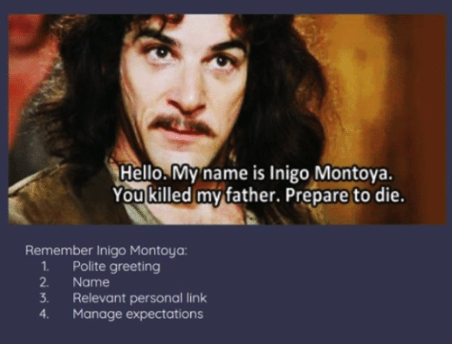
Remember!
Remind me which class! (I teach multiple)
Relative personal link == class you are in ☺
Manage Expectations
Short question

Slide 7
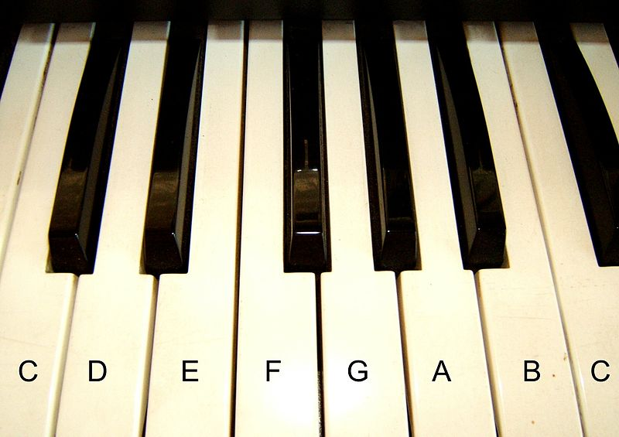


Topics Covered
Basic Java Programming
Variables
Control Structures (Branching)
Loops
Arrays
ArrayLists
Classes
Inheritance
Polymorphism
Essentially - learning the tool to build basic programs!
Problem Solving
Divide-Conquer-Glue
A way to look at the world
Like learning music - programming takes practice, practice, practice
Attribution: Algont

Slide 8
Teaching Approach/Concepts
Based on Psychology of Learning (4 week cycles)
Spacing
Interleaving
Practiced Recall
Elaboration
Reflection
Grading
Formative – Can be redone!
Summative – Demonstrate what you know
You are learning
A new language
A different way of thinking (Divide-Conquer-Glue)
OK to struggle!
To have another language is to possess a second soul. - Charlemagne (748 –814)

Slide 9
Course Structure - Follow Canvas
Readings
Due before Lectures - Sunday, Tuesday and Thursday nights
Lectures
Active learning , a lot of group discussion and coding – BE HERE – or you will miss out.
Labs
Meant to be done after lecture content - coding/writing code
Knowledge Checks
Required to move onto the next module
Your best study tools
Exams
Canvas exams – reading content
Coding exams – writing content
Practical
These are large and hard programming assignments (usually 2 weeks), that bring it all together

Slide 10
Knowledge Checks
Focus on Reading Code
Also help with recall
Best thing to do – go back to them
Interleave – pick different orders to redo them from time to time
Spacing – do some every night!
Psychology of learning – this helps!
Best way to study for exams?
Every night – knowledge checks, practice exam
Retesting + spacing
You can do them 100 times, get different results every time!
Highest result is the one kept
 | ReStudy | ReTesting
Massed
Spaced
Most
People
Ideal For
Recall

Slide 11
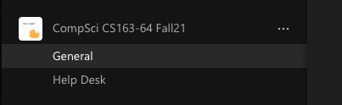
Asking For Help!
MS Teams
Used in industry
We make use for the course (mixed with online and on-campus students)
Install the Application! (not just the browser)
Use the General Channel (Study Group!)
General Questions
Knowledge Checks
Reading
aka, any question that doesn’t require posting code *you* write
Help Desk (TA Code Review)
Specific hours with TAs
A time for someone to look at code *you* write (post, I have a question..)

Slide 12
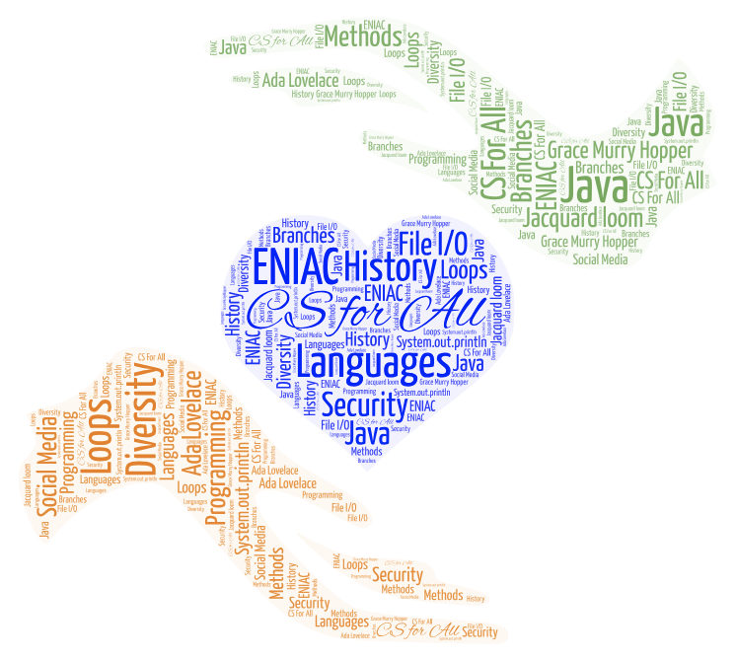
Most Importantly
Remember to Ask Questions
Stay Ahead / Don’t Fall Behind
Be kind to yourself - no one gets everything the first time.
Have fun!
Computer Science is using technology to solve problems!

Slide 13
And who was the first programmer?

Slide 14

The Right Honourable
Countess of Lovelace
Ada Lovelace (1815-1852)
English mathematician who worked with Charles Baggage on his Analytical Engine
In 1843 she translated an article written by the Italian mathematician and engineer Luigi Federico Menabrea, “Notions sur la machine analytique de Charles Babbage” and supplemented it with her own “Notes”
Her “Notes” contains what many consider to be the first computer program
Ability to connect the Arts and Science, she developed a vision of the capabilities of computers to go beyond calculation, it can do anything that can be noted in symbols, including words and music (https://www.britannica.com/biography/Ada-Lovelace/images-videos)
Ada programming language
Ada Lovelace Day – second Tuesday in October
Photo By:
Alfred Edward Chalon [Public domain], via Wikimedia Commons

